Slide 1
Week 11 Interactive Component
Jake Appling

Slide 2
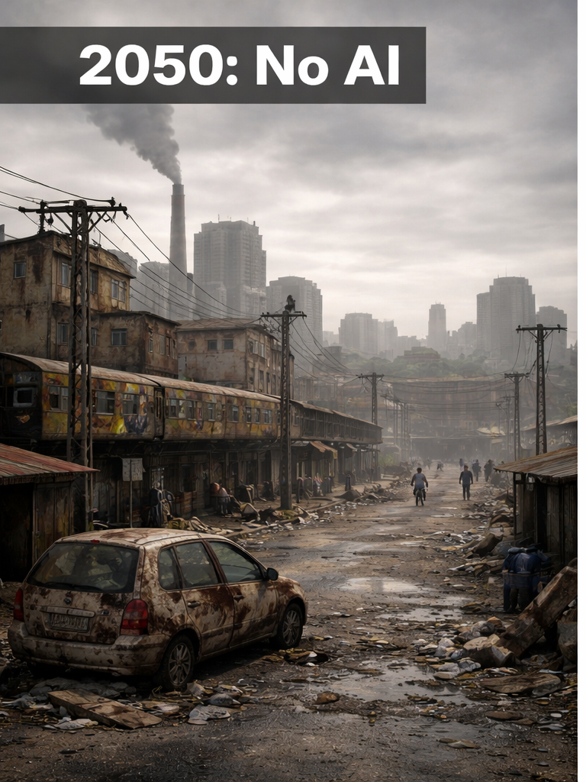
Future without AI’s Impact
Slower innovation in medicine, transportation, engineering, and communication
More tedious busy work done by humans
More delays in services that require coordination
Traditional cities, less automation

Slide 3
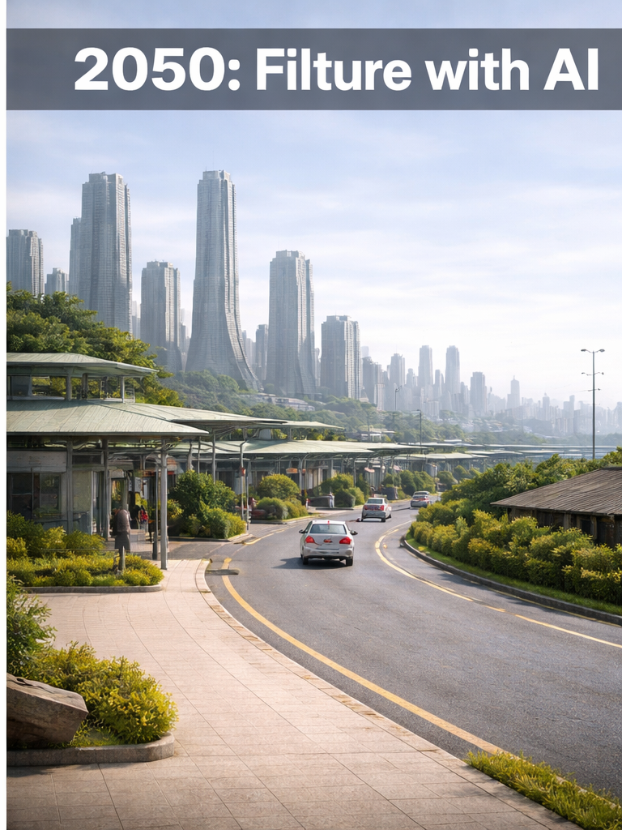
Future with AI
Smart cities with connected traffic systems, energy grids, and public services
Better predictive systems for maintenance, weather response, logistics, and safety
Faster advances in healthcare, science, transportation, and infrastructure
Daily life may become more convenient through automation and predictive systems

Slide 4
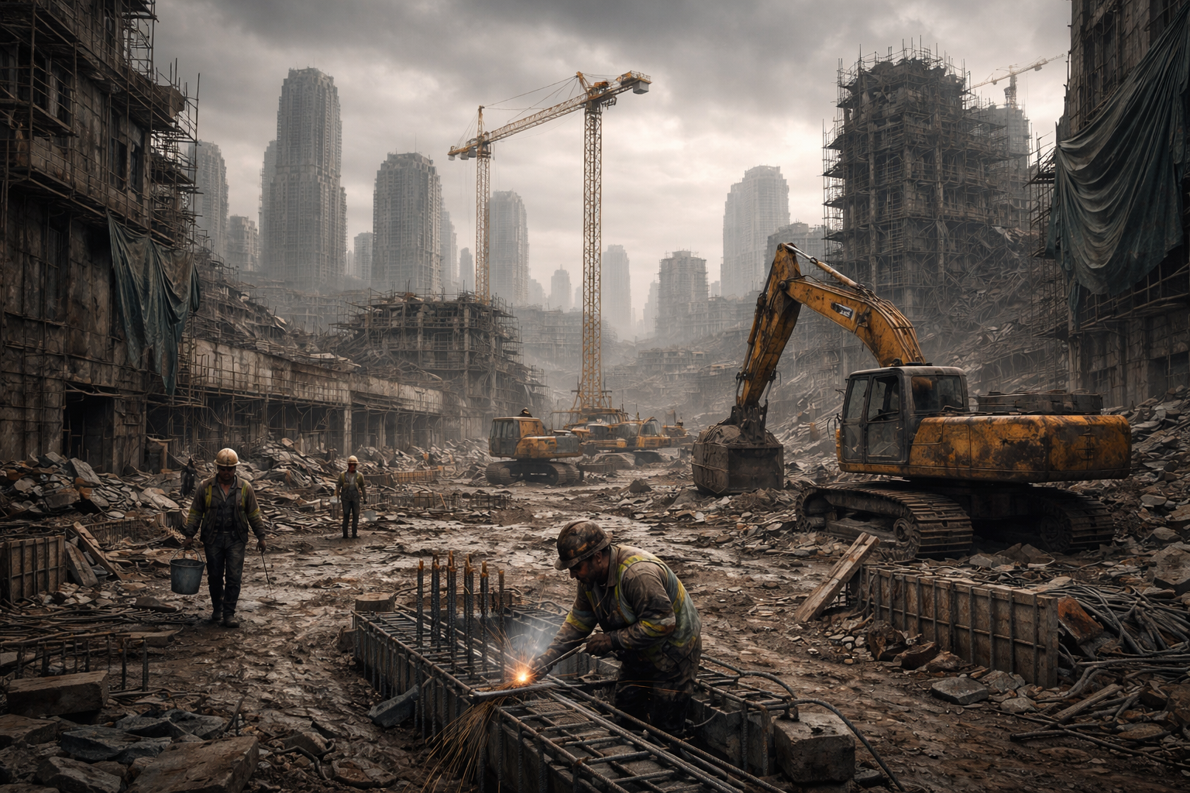
Construction without AI
More frequent delays caused by communication gaps and slower decision-making
Safety monitoring relying mainly on supervisors
More rework because clashes, errors, or sequencing issues may be caught later
Human labor doing more of the layout, inspection, and quality-control work

Slide 5
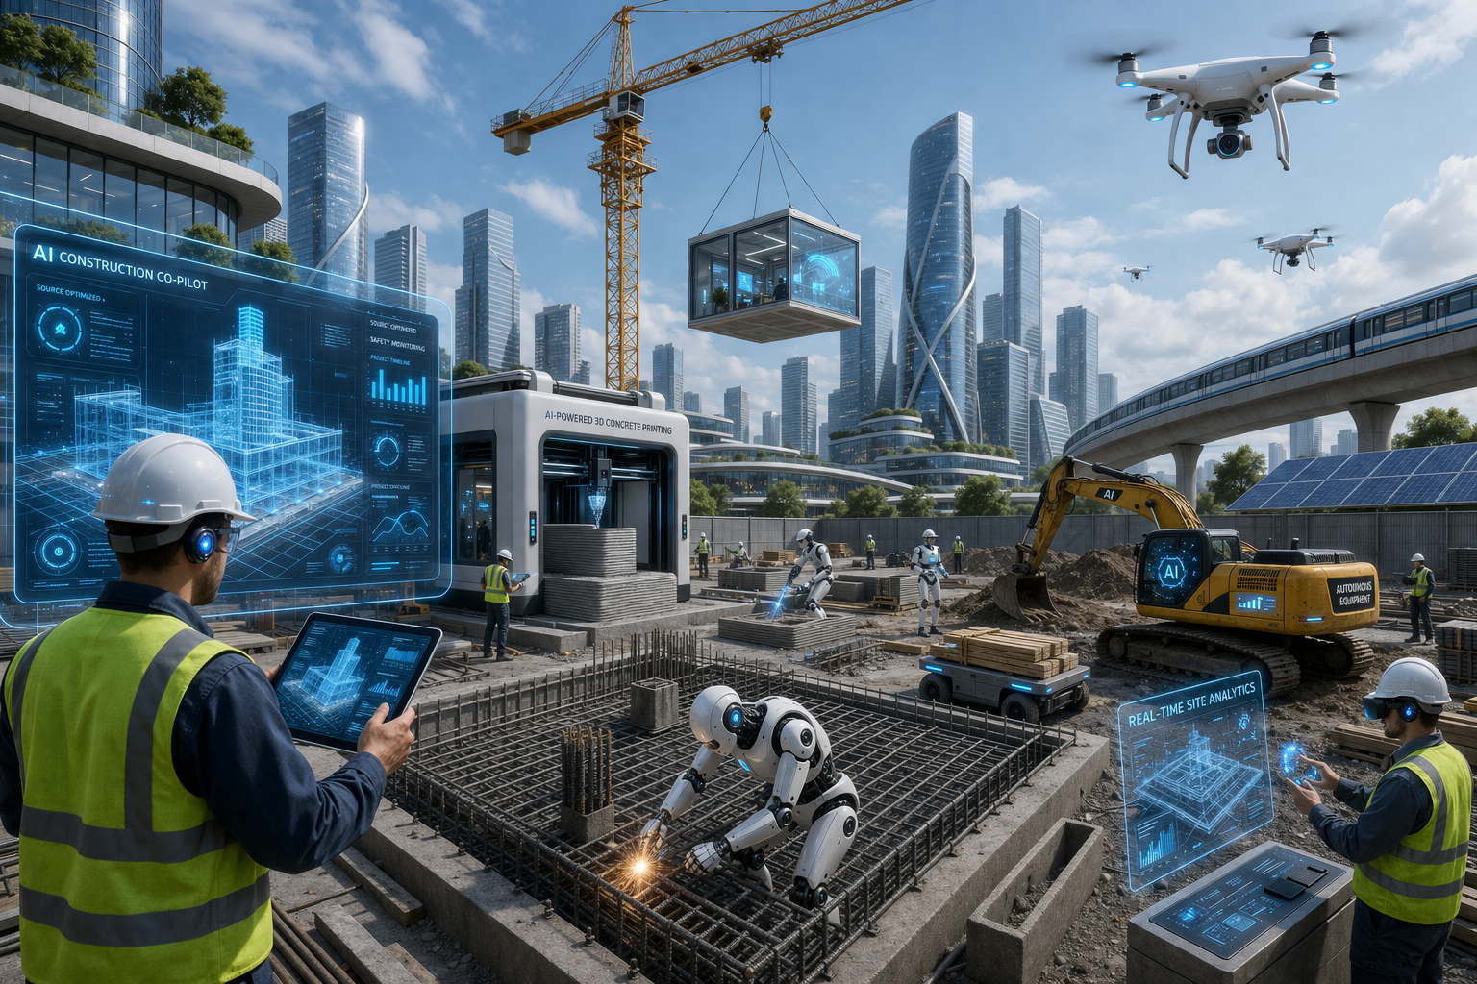
Construction with AI
Drones and cameras tracking progress automatically
Predictive maintenance for heavy equipment and tools
Robots or autonomous machines handling repetitive or hazardous tasks
AI support for estimating, risk analysis, and resource planning
Smarter material logistics that reduce waste and delivery problems

